Slide 1
Employee Data Analysis using Excel
STUDENT NAME:M.HARINI
REGISTER NO: 312216375
DEPARTMENT:B.COM CA 3rd YEAR
COLLEGE: SHRI SHANKARAL SUNDARBAI SHASUN JAIN COLLEGE FOR WOMEN.

Slide 2
PROJECT TITLE
Employee Performance Analysis using Excel

Slide 3


AGENDA
Problem Statement
Project Overview
End Users
Our Solution and Proposition
Dataset Description
Modelling Approach
Results and Discussion
Conclusion
3/21/2024 Annual Review

Slide 4

PROBLEM STATEMENT
A problem statement is a concise description of a project's issue or challenge that helps define the project's goals and objectives. It's a key tool in project management that helps teams focus on the problem, identify opportunities for improvement, and develop strategies to solve it.

Slide 5

PROJECT OVERVIEW
A project overview is a detailed description of a project's goals and objectives, the steps to achieve these goals, and the expected outcomes. In addition, a project overview enables you to outline the project schedule, budget, necessary resources, and status.

Slide 6

WHO ARE THE END USERS?
The term end user is used to distinguish the person who purchases and uses the good or service from individuals who are involved in the stages of its design, development, and production.
Operators of end user: Customers Employees Tenants Visitors

Slide 7

OUR SOLUTION AND ITS VALUE PROPOSITION
A value proposition is a marketing statement that explains why a customer should buy a product or use a service. It's a key part of a company's overall marketing strategy and helps differentiate the brand.

Slide 8
Dataset Description
A dataset is a collection of organized data that can be used for a variety of purposes, such as research, analytics, and machine learning.A dataset is a collection of related data that is organized and stored for analysis or processing

Slide 9

THE "WOW" IN OUR SOLUTION
Wowing your customers creates deeper loyalty and delight and promotes meaningful usage for years to come. They have rooms to keep clean, bookings to manage, and other, more pressing things that need to get taken care of.
3/21/2024 Annual Review
9

Slide 10
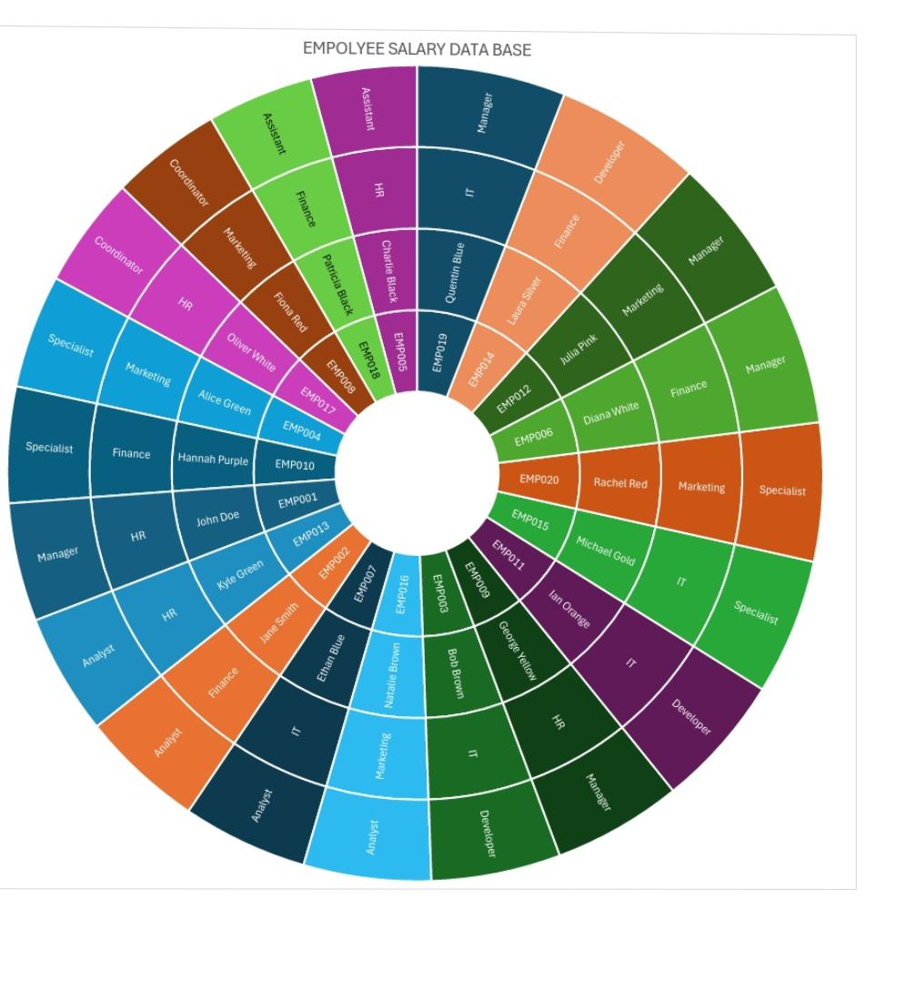
MODELLING
10

Slide 11
RESULTS
Create a Results Sheet: Set up a dedicated sheet for displaying results and summaries.Use Clear Labels: Clearly label each section of the output for easy understanding.
11

Slide 12
conclusion
In an Excel project, a conclusion typically summarizes the key findings, insights, and implications derived from the data analysis. Here’s a general structure.Summarize Key Findings: Briefly restate the most important results. Interpret the Results: Explain what the findings mean in the context.Implications: Discuss the practical implications of your findings.

